Slide 1
Needfinding
Technology for Mental Health
Riley, CJ, Grace, Ginelle

Slide 2
01
02
03
Our Team
Problem Domain
Methodology & Participants
04
05
Interview Analysis
Takeaways

Slide 3
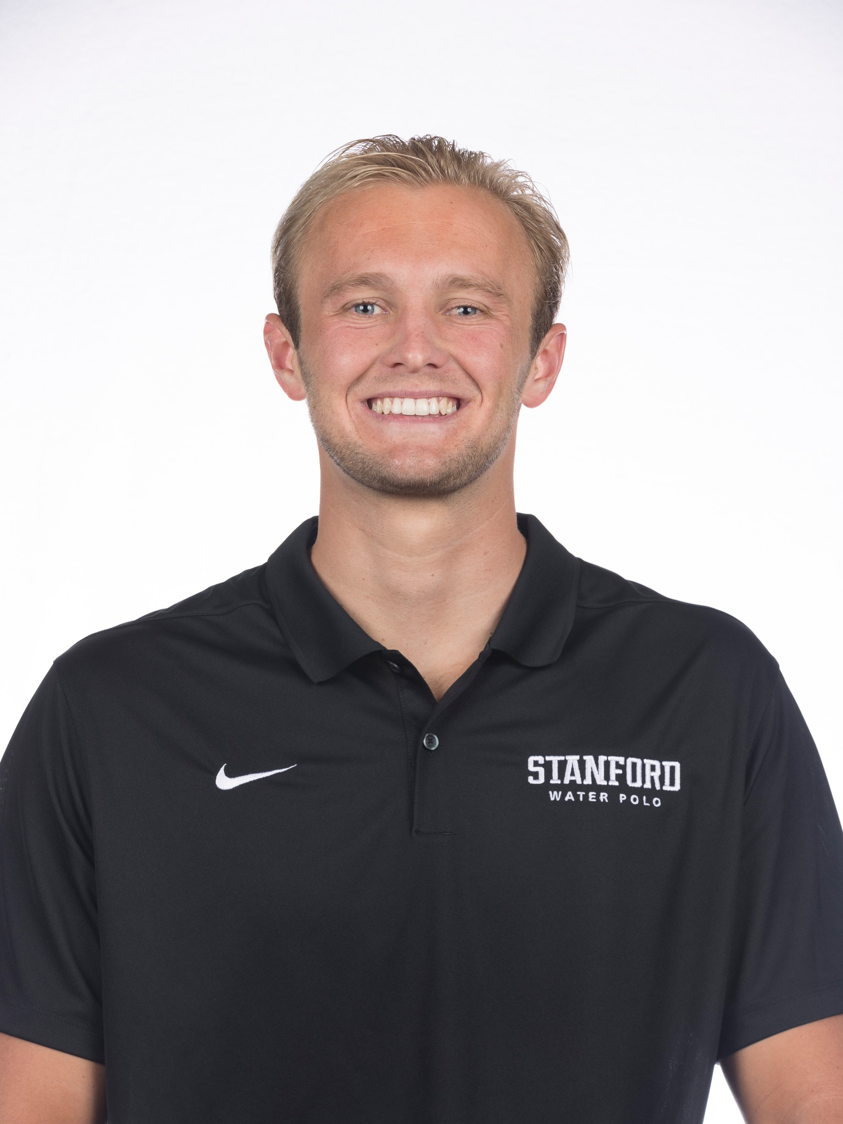
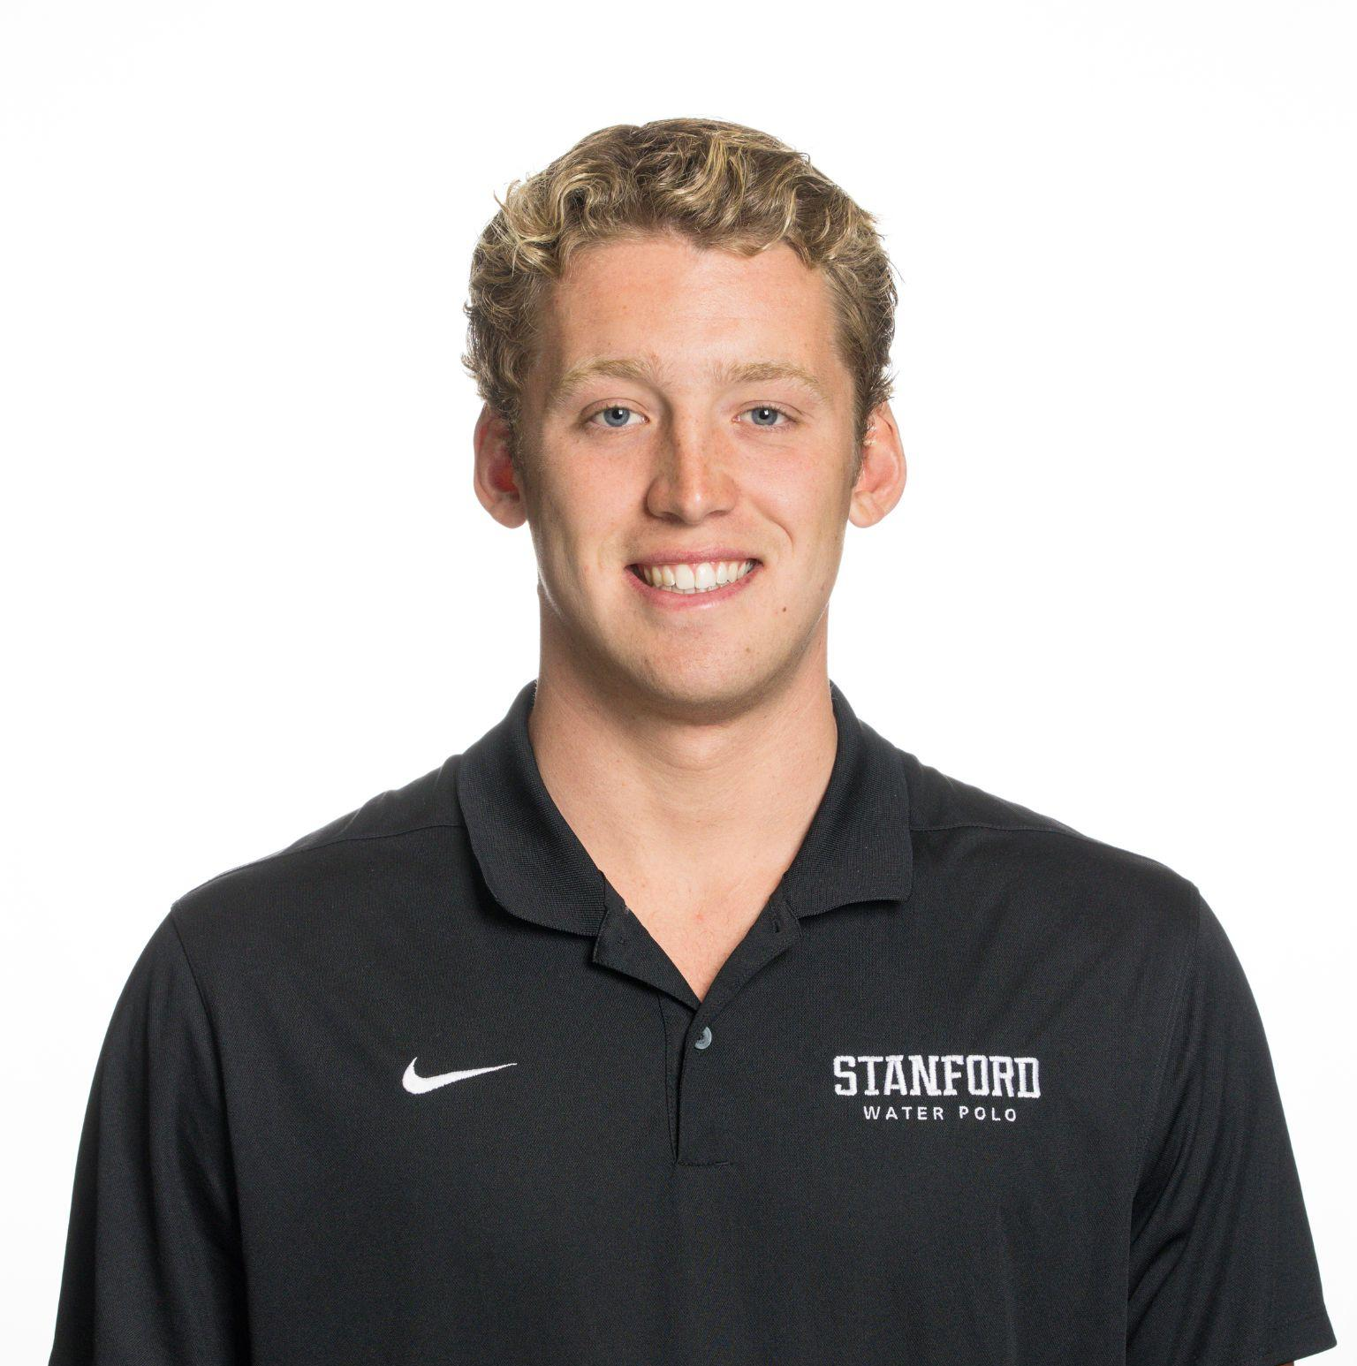
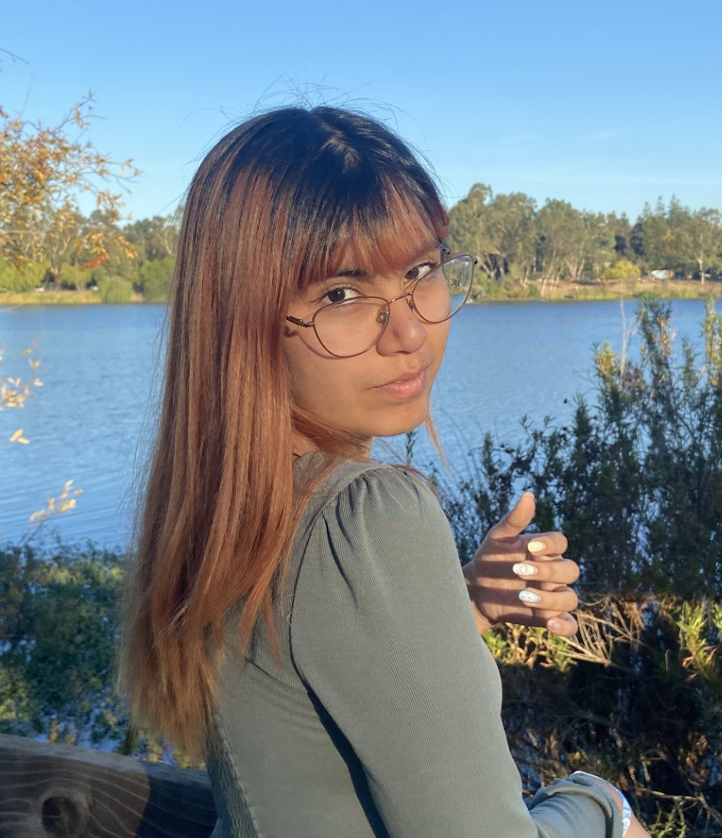
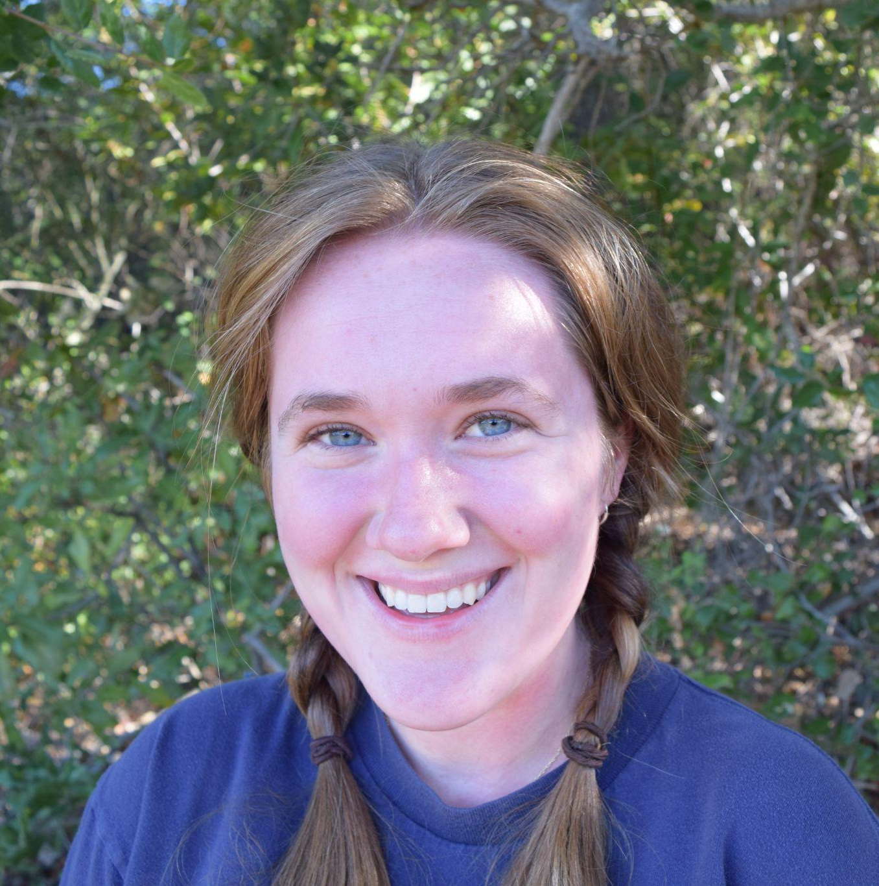
Our team
CJ Indart
Ginelle Servat
Grace Miller
Riley Pittman
CS Undergrad in HCI
SymSys Undergrad in HCI
CS Undergrad in AI
CS Undergrad in AI,
CS Coterm in HCI

Slide 4
Problem Domain
College- and newly post-college-aged students in the US
Focused on concerns about post-graduate life

Slide 5
Methodology

Slide 6
Participants
Sara
Alexandra
Graduate student studying school counseling in Iowa City
Community college commuting student from North Miami
Emily
Trevor
Undergraduate student-athlete at Stanford
College graduate & behavioral therapist job seeking in Menlo Park

Slide 7
Emily
Junior field hockey player at Stanford studying MS&E
CJ recorded and took notes
Riley asked questions

Slide 8
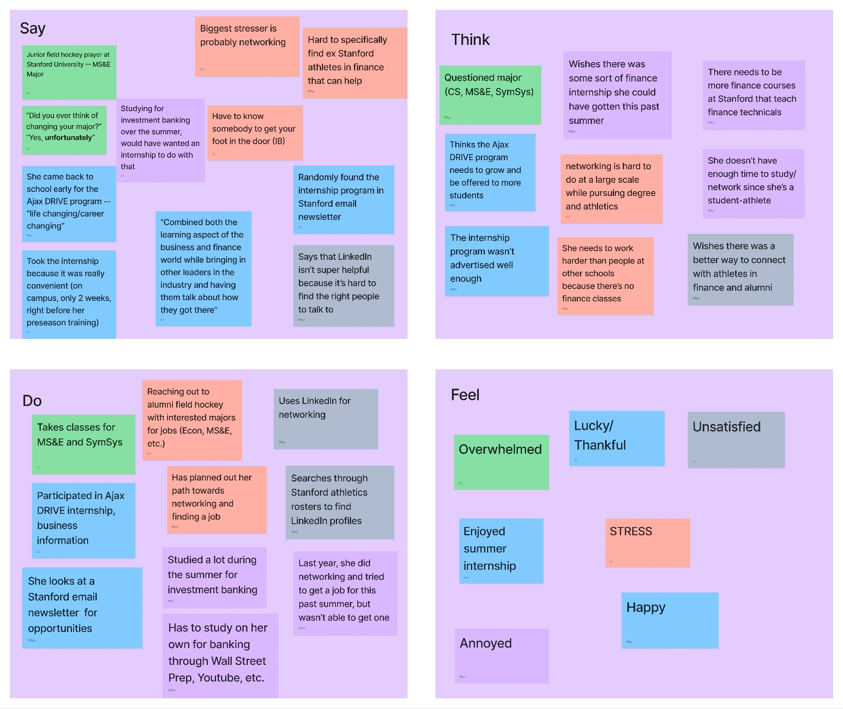
Emily
Notes:
Sticky notes are color coded based on topics that we covered with her
Example: Green is her talking about her major and classes – blue is internship over the summer…

Slide 9
Key Quotes/Findings
Her “biggest stressor is networking” and finding a job
Wishes it was easier to connect with former Stanford athletes in finance and the professional world
She uses LinkedIn, but it’s “hard for her to find the right people”
Notes:
Specifically for the questions asked part, the arrows mean the initial question led to the secondary question. Conversations about her summer and what she did led to asking about internships, how they were, did she like them, does she want more. etc.

Slide 10
Alexandra
3rd year community college student in Miami studying Cybersecurity
Manages a part-time job while being a leader in the classroom
Ginelle interviewed, took notes, and recorded
Notes:
Where: this was scheduled through Zoom
Ginelle recorded, took notes, and held interview

Slide 11
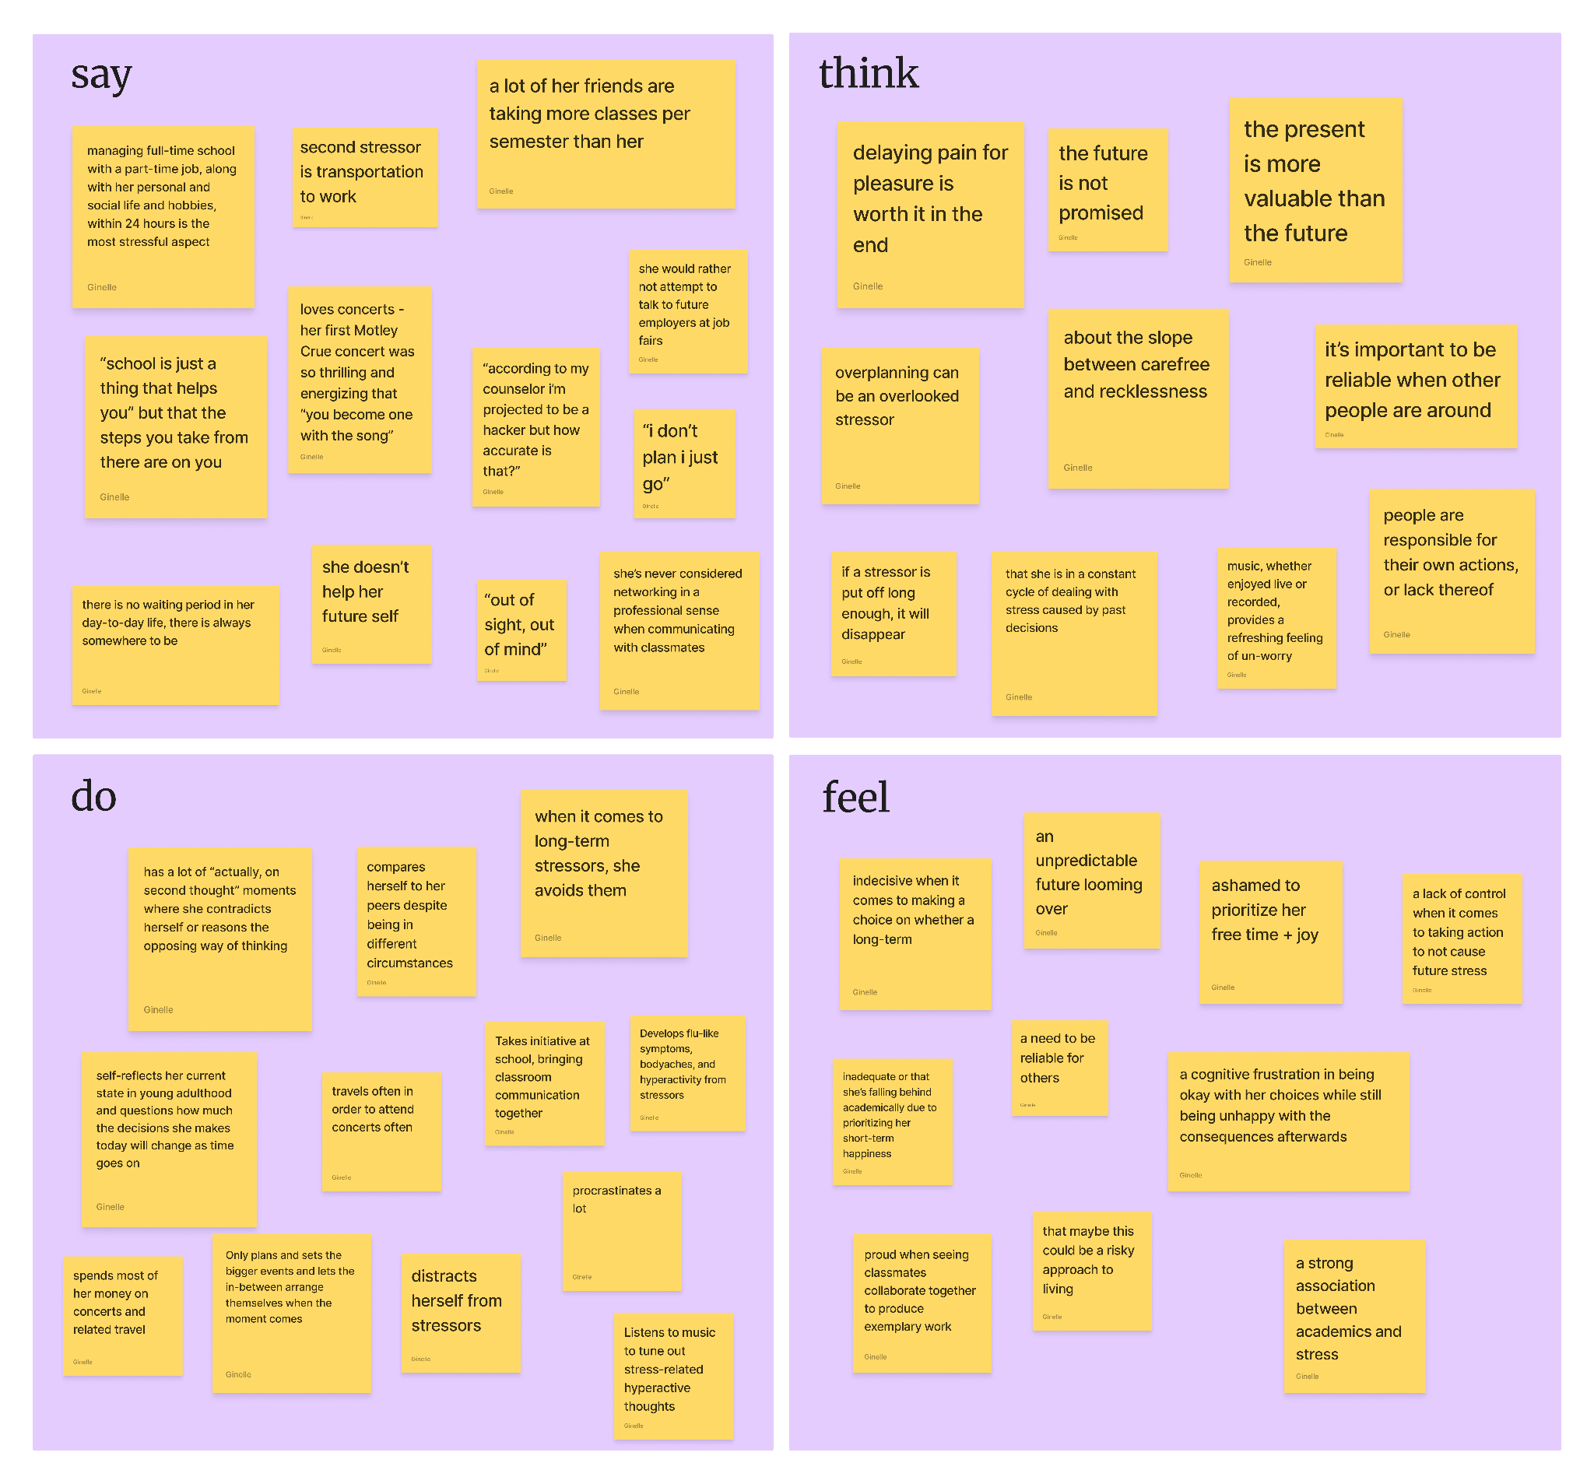
Alexandra

Slide 12
Key Quotes/Findings
“Out of sight, out of mind” is how she approaches the future.
Fears an imbalance between her future and staying true to her passions.
Two types of stress: while there was a big stressor placed on academics as the immediate surrounding environment, there was not a connection made between it and long-term post-graduate career plans.
Notes:
“Out of sight out of mind” is how she views the stress caused by thinking of the future WHEN she seals it away through

Slide 13
Sara
Graduate student at the University of Iowa studying to be a school counselor
Collegiate rugby player hoping to go pro
Graduates college in spring 2025
Grace interviewed and took notes

Slide 14
Sara
Say
Think
Main stressors are finances and lifestyle post-graduation
Her graduate program does an excellent job of connecting students with job opportunities
Confident about her choice of career path
Career path is extremely dependent on location of school district and regional government policies
Chosen career path provides relatively low pay
Currently in a difficult transitional period characterized by uncertainty
Rugby team is a good fallback for mental health and emotional support
More worried about post-graduate lifestyle than about finding jobs specifically
Concerned about potential challenges with lifestyle impacting her performance at work
Unsure how to make friends at work outside of rugby
Trying to determine location based on state and licensure policies, proximity to family and “vibes of the place”
Concerned about cost of living
Hoping to play rugby professionally post-graduation, so location choices are also restricted by availability of athletic opportunities
Do
Feel
Plays rugby at the collegiate level
Actively pursues professional rugby opportunities
Seeks jobs via Indeed, LinkedIn, Handshake
Talks to school advisors and goes to career center
Goes straight to the school district to ask about school counselor openings
Relies heavily on rugby team socially and emotionally
Journals
Goes to therapy
Meditates
Anxious
Worried
Concerned
Uncertain
Stressed
Performance anxiety
Isolated
Lonely

Slide 15
Key Quotes/Findings
More concerned about quality of postgraduate life than about finding a job
Concerned about isolation and making friends
Relies heavily on her sports team for mental health resources and community

Slide 16
Trevor
Recent graduate from Santa Clara University with an undergrad in psychology
Living at home and working as a behavioral therapist while pursuing further education in psychology
Edge case - college graduate currently jobseeking
Grace interviewed and recorded

Slide 17
Trevor
Say
Think
Main stressor is certainty about whether he has chosen the right career path
“Before this, I never worried about what my future was going to be, because it was so easy in college”
Worried about “hypothetical incomes 8 years from now”
“Is this investment worth it? Am I wasting five years of my life to pursue something that’s going to be a dead end?”
Knew he wanted to be a psych major since before entering college, but previously studied business out of pressure to pursue something more “predictable”
“You spend 80% of your adult life doing work. If you hate your job, you’re going to hate your life”
Concerned about job satisfaction and lifestyle outcomes down the road
Doesn’t feel well-connected
Would rather make half as much money and do something he enjoys than do something he hates for the price tag
Still doubts whether he did the right thing by swapping from business to psychology
“Doesn’t know enough about what careers are out there” to seriously consider many alternatives
Worries about whether he’s spending his time correctly in the immediate future, looking for the right jobs
Wishes class was in-person
Do
Feel
Talks to professors about post-grad opportunities
Talks to mental health professionals in his life (family friends, etc.)
Studies for masters at night
Uses Handshake to look for jobs
Gym for mental health
Socializes with post-college age range for mental health
Anxious
Focused
Isolated
Unrooted
Serious
Pressure

Slide 18
Key Quotes/Findings
Most concerned about job satisfaction and whether he’s chosen the right career path
Doesn’t feel like he has adequate resources to figure this out or explore alternatives

Slide 19
Summary & Takeaways
Impending and recent college graduates feel a lack of resources for genuinely connecting with professionals in their field
Both job availability and career fulfillment are concerns
Graduates worry about feeling socially isolated after leaving college
Stress about the future can lead college students to be avoidant of career objectives

Slide 20
Next Steps
Narrow scope and conduct more specific, targeted interviews with pre-determined questions
Interview more non-Stanford students in the Bay Area
Interview alumni and professionals about their advice for and willingness to connect with students
Randomize interviewees

Slide 21
Thank you!

